Slide 1
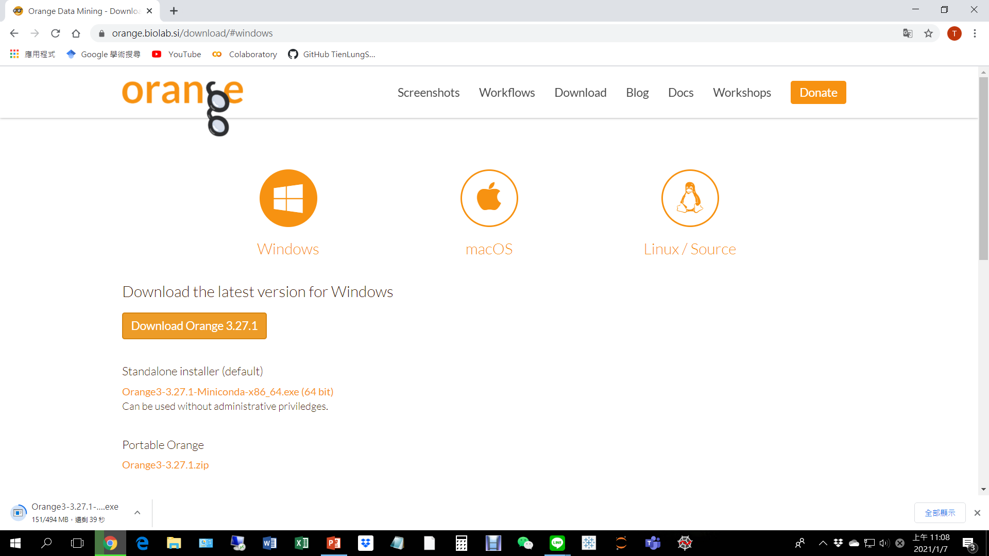
https://orange.biolab.si/

Slide 2
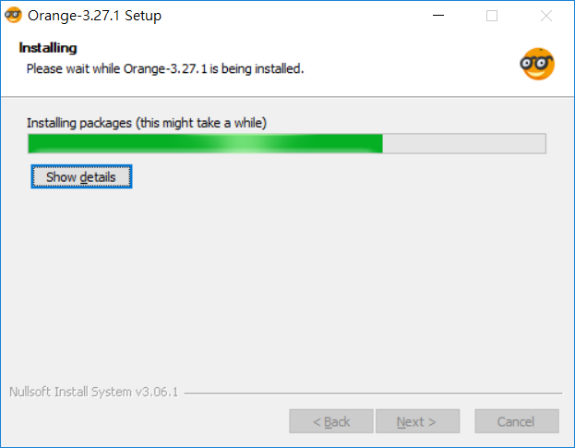
Takes a while (5 min) to install

